Slide 1
Moral Values that Promote or Hinder the Rule of Law Institutional Setting a large N quantitative approach
Study supported by the NKFHI (Hungarian Research Fund) Project No. 143831
György Gajduschek
Senior researcher
Centre for Social Sciences, Institute for Legal Studies

Slide 2
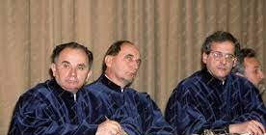
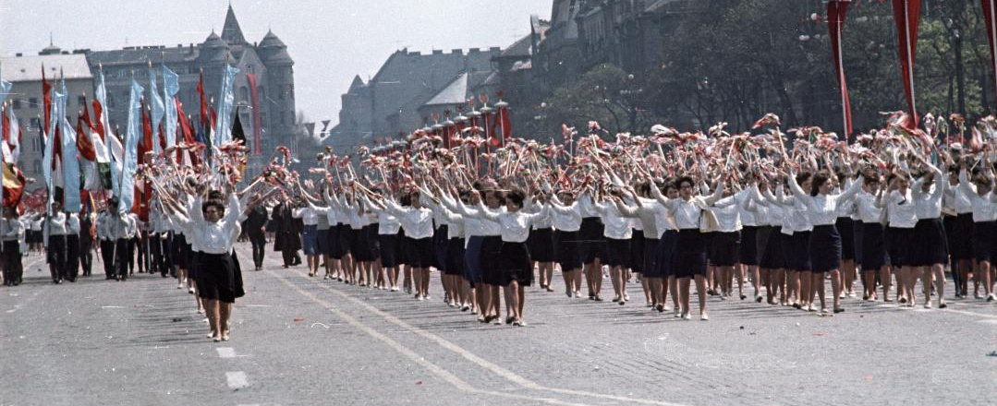
Piotr Sztompka reflecting on the introduction of the rule of law arrangement after the collapse of communism arguing that:
a specific "civilisational background" is necessary for formal institutions to function effectively: “the soft tissue of […] society, the intangible assumptions, premises, understandings, rules and values” is what lies behind and below institutions”
Sztompka, P. (1996). Looking back: The year 1989 as a cultural and civilizational break. Communist and Post-Communist Studies, 29(2), p. 117
1989

Slide 3
Culture seems to be an intangible subject, evidently requiring qualitative research.
Still, from the 1980 an increasing number of empirical studies attempt to capture some relevant elements of societal culture (especially: values).
I will present some preliminary results of a research investigating the statistical and presumably causal relationship between cultural values on nation level and Rule of Law (RoL) indexes assessing institutional setting. The formal and informal relationship.

Slide 4
The research
THE THEORY
Culture is dominant
May be stronger than such „hard” variables such as GDP/capita, govt. spending, employment rate, GINI
Statistical relationship indicates Culture → RoL causal relationship as culture changes slowly
METHOD
RoL data collected (various sources); here World Justice Project data is used. Four sub-indexes generated.
Various cultural concepts and related variables are collected
Both variables from all around the World. Great variety: poor-rich; democratic-authoritarian, etc.

Slide 5
Predictive power of cultural constructs for RoL (adj. R²)
Statistical relationship vs. Causal relationship
Cultural construct | WJP Overall | Formal | Substantive | Democracy
Schwartz | 0.530 | 0.488 | 0.567 | 0.537
Hofstede | 0.571 | 0.573 | 0.519 | 0.518
Globe-Values | 0.655 | 0.659 | 0.575 | 0.569
Globe-Practices | 0.647 | 0.689 | 0.571 | 0.573
Inglehart Wave7 | 0.743 | 0.721 | 0.655 | 0.667
Welzel Wave7 | 0.746 | 0.697 | 0.716 | 0.724
Minkov-Kaasa 2022 | 0.661 | 0.646 | 0.599 | 0.587
Gelfand tightness–looseness | 0.346 | 0.307 | 0.414 | 0.385
Control variables: four items | 0.713 | 0.702 | 0.615 | 0.555

Slide 6
Main results:
Expected
  Culture is a strong influential variable; some stronger than some hard data (GDP/capita)
Surprising:
  Culture influences RoL level in all political systems, including authoritarian ones
  Substantive RoL elements are less reactive to culture than formal ones (vs. theory: Fuller and others)

Slide 7
Hofstede (expected strength with green, surprising with red)
Dimensions | Overall WJP |  | Formal Rol |  | Substantive RoL |  | Democracy in RoL
 | Corr. | Part | Corr. | Part | Corr. | Part | Corr. | Part
Power Distance !!!- | -.653 | -.296 | -.657 | -.291 | -.603 | -.306 | -.626 | -.276
Collectivism-Individualism !!!+ | .629 | .187 | .629 | .190 | .550 | .132 | .588 | .173
Feminity-Masculinity (Success) | -.186 | -.137 | -.209 | -.164 | -.214 | -.151 | -.165 | -.116
Uncertanity Avoidance ↓- | -.139 | .001 | -.184 | -.044 | -.011 | .110 | -.077 | .054
Long-term Orientation ↑ Monumentalism-Flexhumility | .301 | .283 | .292 | .266 | .291 | .305 | .232 | .267
Indulgence-Restraint ↓ | .150 | .128 | .129 | .103 | .185 | .173 | .249 | .210
Notes:
Generally expected and already described:
Power distance – strong negative relationship. If power distance is large position in the hierarchy may be more relevant that generally applicable legal rules.
Individualism – modern law is based on individualism, especially basic rights, that defend individual human rights and minority rights over the majority’s interest. However, the weakest is in „Substantive” element. (But the others are week for substantive too)
Uncertainty avoidance: Law, as a normative system and especially as to only generally valid/obligatory normative system is considered as one of the most substantive element of minimizing uncertainty in the society. Requires further research why this relationship in this form does not work? Even the sign is negative.
Restraint – law as a major normative system is the manifestation of „restraint” but this does not seem relevant.
Surprisingly relevant the flexhumility, that is especially characteristic for East Asian cultures; not the frontrunners of the RoL. Needs further research. Especially high for part correlation, indicating that it contains an element that is not in most of the others but largely overlaps with collectivism.

Slide 8
Inglehart, Welzel, Gelfand
Dimensions | Overall WJP |  | Formal Rol |  | Substantive RoL |  | Democracy in RoL
 | Corr. | Part | Corr. | Part | Corr. | Part | Corr. | Part
Traditional – Secular/rational | ,754 | ,325 | ,749 | ,328 | ,689 | ,268 | ,632 | ,168
Survival – Self-expression | ,803 | ,426 | ,788 | ,410 | ,770 | ,436 | ,805 | ,526
Secular | ,470 | -,102 | ,449 | -,107 | ,498 | -,055 | ,470 | -,092
Emancipative +++ | ,862 | ,730 | ,833 | ,710 | ,849 | ,690 | ,850 | ,714
Gelfand - Restraint | ,598 |  | ,565 |  | ,652 |  | ,629
Notes:
Inglehart: Both are highly relevant
Welzel: Self-expression is dominant, extremly strong predictive power.

Slide 9

Results so far & Next steps
Hofstede (and Schwartz, Globe, Gelfand) is easier to interpret;
  Some surprising results for cultural indicators that need to be explained
  Substantive RoL seems generally to correlate least with culture - counterintuitive
Inglehart and Welzel have very high predictive power (especially Emancipative), but it is more difficult to interpret.
Further research:
  Looking for causal mechanisms between cultural variables and RoL, especially for variables that behave counter-intuitively
  Breaking down some variables, most importantly, the „Emancipative” one
  Looking for the relationship between various cultural variables
  Possibly generating variables specifically relevant to explaining RoL from WVS data.

Slide 10
Thank you
Questions, Comments?

Slide 12
Submitted via Oxford Abstracts (Gajduschek.gyorgy@tk.huszokásosjelszóazújlatinhőssel) 2025-10-28
To Socio-legal Studies Association Annual Conference at the University of Sussex, 30 March–1 April 2026
Stream: Exploring Legal Borderlands: Empirical and interdisciplinary methods
Moral Values that Promote and Hinder the Rule of Law Institutional Setting
Abstract:
This paper explores the “borderlands” between formal law and informal normative orders by examining how moral and cultural values shape the institutionalization of the Rule of Law (RoL) across societies. Beyond government-enacted legislation, informal norms and shared values continue to regulate social behaviour, even in modern states. These informal systems of meaning interact dynamically with formal legal structures, forming a key site of socio-legal interactivity.
Using a cross-national quantitative analysis of approximately 80 countries, this study investigates statistical relationships between major cultural value indicators—such as those proposed by Hofstede, Schwartz, Inglehart, and Welzel—and national RoL measures provided by the World Justice Project. The results highlight values that appear to promote or hinder the robustness of legal institutions: for instance, individualism correlates positively with RoL, while power distance correlates negatively, as expected. Yet, uncertainty avoidance shows no significant association, challenging conventional assumptions.
The paper argues for a predominantly causal direction from cultural values to legal institutions (Values → RoL) and situates this within the conceptual “borderland” between law and non-law, where formal structures depend on the moral and cultural frameworks that sustain them. Methodologically, it reflects on the possibilities and limitations of quantitative approaches in capturing such informal legal dynamics, contributing to interdisciplinary debates on how social values influence, and are influenced by, evolving legal orders.

